Slide 1

Data Visualization
Presented by:
Elizer Ponio Jr.
Department of Computer Science
College of Computing and Information Technologies

Slide 2
Outline
What is Data Visualization?
Types of Visualization
Selecting the type of Visualization

Slide 3
What is Data Visualization?
Data visualization is the representation of data through use of common graphics, such as charts, plots, infographics, and even animations.
These visual displays of information communicate complex data relationships and data-driven insights in a way that is easy to understand.

Slide 4




Data Visualization Libraries

Slide 5

What is Data Visualization?
Types of Visualization
Selecting the type of Visualization

Slide 6
Types of Data Visualization
There are many types of data visualization. Some of the most common types used are:
Column Chart
Line Graph
Bar Chart
Heat Map
Scatter Plot
Histogram
Chloropleth Map

Slide 7
Column Chart
They are a straightforward, time-tested method of comparing several collections of data. A column chart may be used to track data sets across time.

Slide 8
Line Chart
A line graph is used to show trends, development, or changes through time. As a result, it functions best when your data collection is continuous as opposed to having many beginnings and ends.

Slide 9
Bar Chart
To compare data along two axes, use bar charts. A visual representation of the categories or subjects being measured is shown on one of the axes, which is numerical.

Slide 10
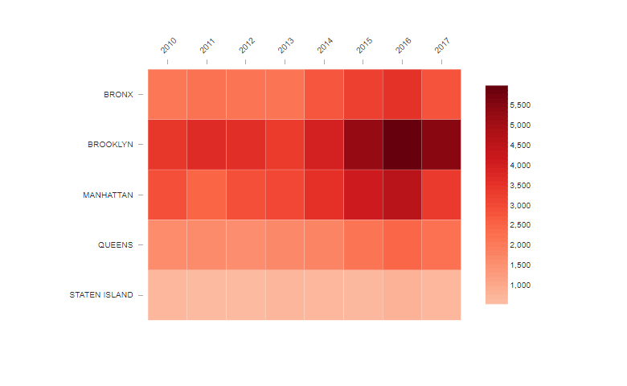
Heat Map
A data visualization method that uses colors to denote values; great for seeing trends in huge datasets.

Slide 11
Scatter Plot
The correlation between variables is examined using a scatter plot. At the point where the data's two values overlap, the data are represented on the graph as dots.

Slide 12
Histogram
While a histogram and a bar graph are similar, they use distinct charting systems. The ideal sort of data visualization for frequency-based analysis of data ranges is a histogram.

Slide 13
Chloropleth Map
The technique of color mapping symbology is used to create choropleth maps, which are themed maps used to display statistical data. It shows geographically segmented sections or regions that are colored, shaded, or patterned according to a data variable, known as enumeration units.

Slide 14
What is Data Visualization?
Types of Visualization
Selecting the type of Visualization

Slide 15
How to Select the Appropriate Type of Visualization for Your Data?

Slide 16
Selecting the Type of Visualization
To successfully express your message and insights, selecting the appropriate chart or graph for your data is essential.
The factors that needs to be considered while choosing the optimal data visualization are Purpose, Type of Data and Context

Slide 17
Selecting the Type of Visualization
Purpose
What are you trying to visualize? Are you attempting to demonstrate contrasts, patterns, or connections in your data?
Type of Data
What kind of data do you have? Is it a numerical or category list? Both continuous and discrete? This will aid in choosing the best types of data visualization charts.
Context
What context does your data come from? Is it recent or historical? Local or worldwide? This will enable you to choose the proper scale and coverage for your visualization

